Slide 1
Pair Programming
Using the strengths of two programmers
Please Sign in

Slide 2
Steve Thering
PLTW Master Teacher
Technology Education Teacher in Pittsford NY
Proud Father of 3
Varsity Ice Hockey Coach

Slide 3
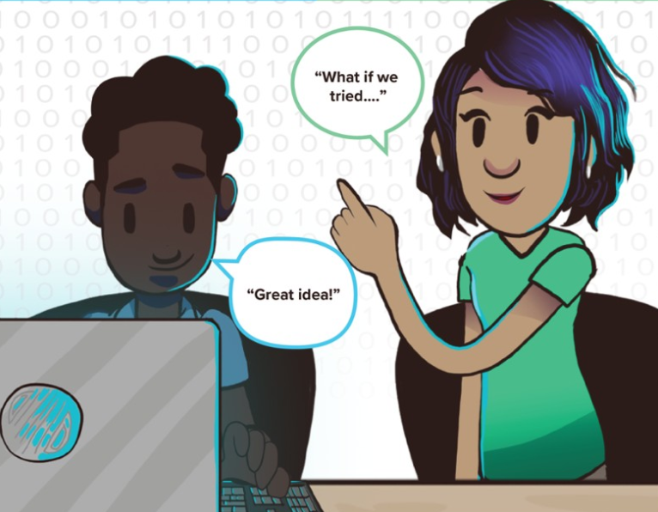
The Roles of Pair Programming
Using the strengths of both the Driver and Navigator to solve the problems at hand

Slide 4
Driver
Writes and Modifies the code
Controls the computer or tablet
Transfers/downloads the code to the external device

Slide 5
Navigator
Keeps hands off computer
Reviews the Code
Identifies potential errors
Proposes ideas or suggestions
Completes wiring of external devices
Documents in Design Journal/ Engineers notebook

Slide 6
Creating Norms
With the people sitting around you discuss the following:
What type of norms do you need to keep in mind?
What makes a good pair programming team?

Slide 7
Creating Teams
How do you break a class into groups of two?
What if you have an odd number of students?
What are some effective ways to create successful teams?
(high flyer vs. low flyer)

Slide 8
Timing
How often do you rotate?
Balanced work load

Slide 9
Facilitation
As a facilitator what does it look like?
What type of questions do you pose?
What is your role as a facilitator?

Slide 10
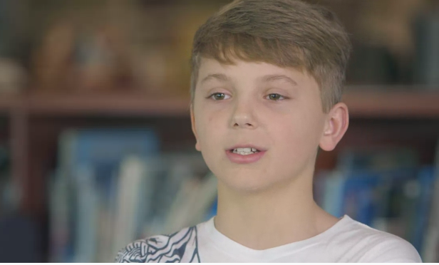
Student Perspective

Slide 11
Bringing it home
When done effectively what does it look like?

Slide 13
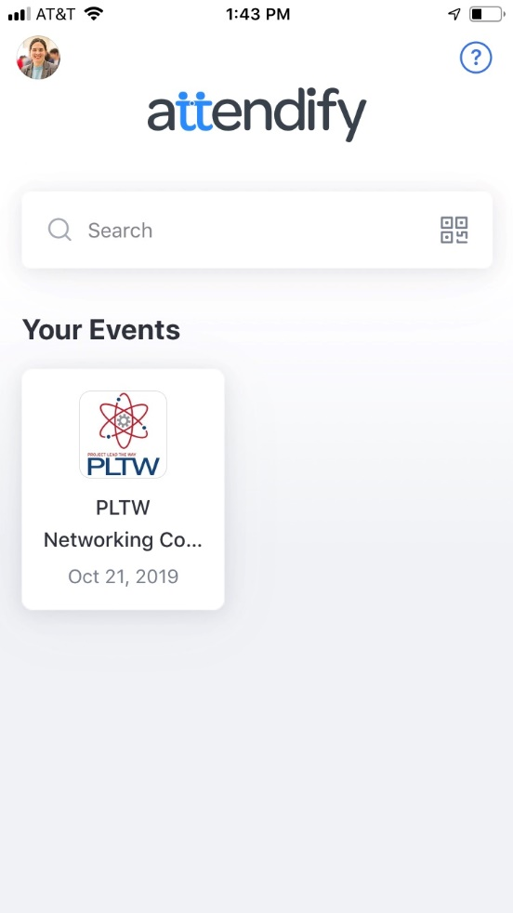
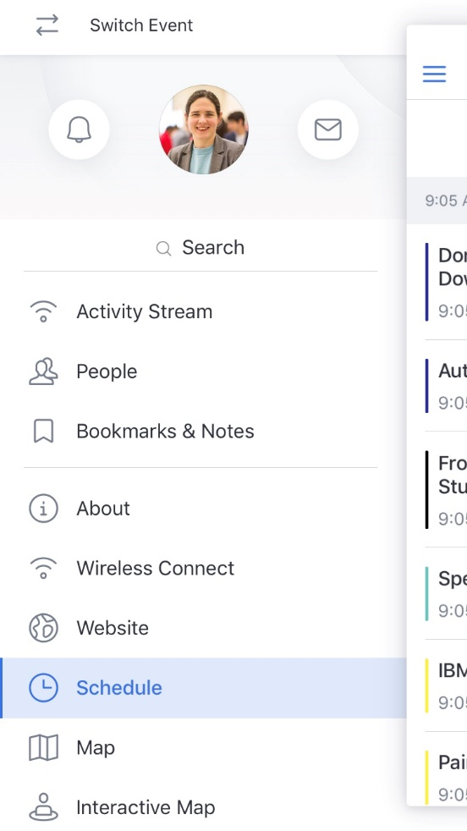
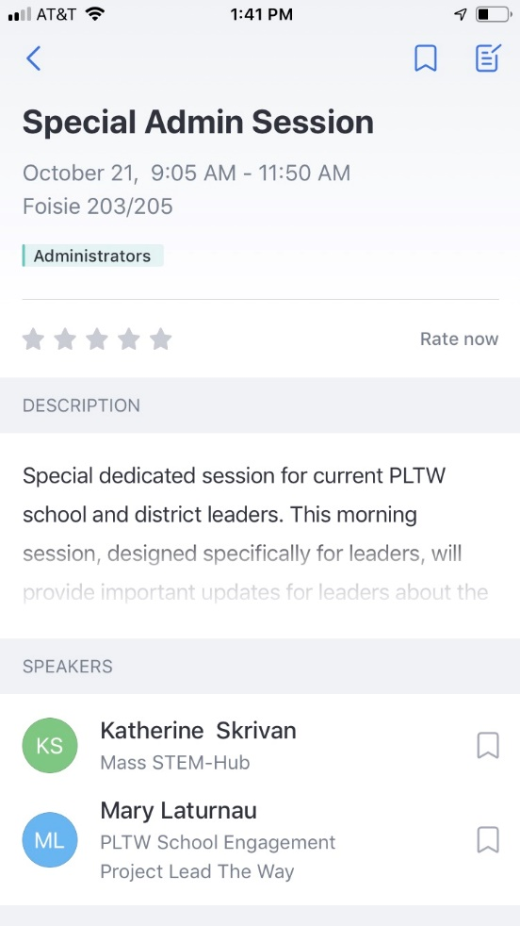
Rate this session in the conference app!

