Slide 1
Pacing
Balance between covering content an student retention
Please Sign in

Slide 2
Steve Thering
PLTW Master Teacher
Technology Education Teacher in Pittsford NY
Proud Father of 3
Varsity Ice Hockey Coach

Slide 3
Do you need to cover everything in curriculum?

Slide 4
What do you trim?

Slide 5
Where can you speed up Where do you slow down?
Ways to check for understanding
Formative vs Summative

Slide 6
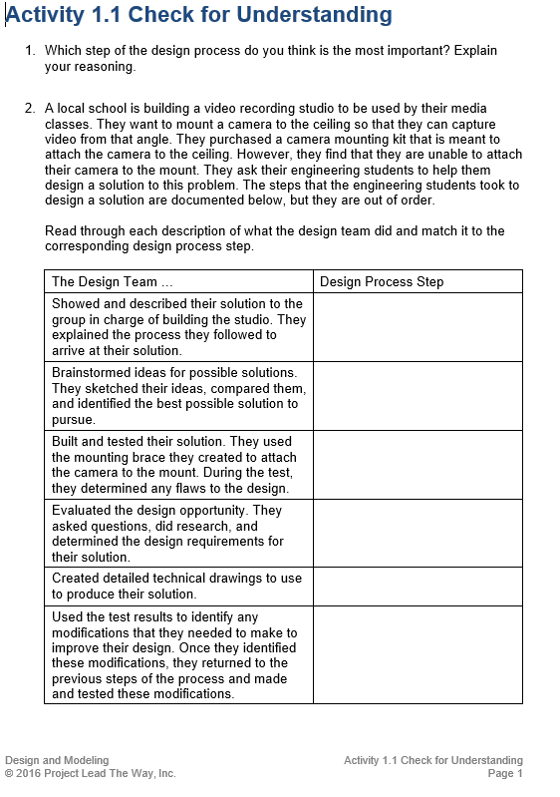
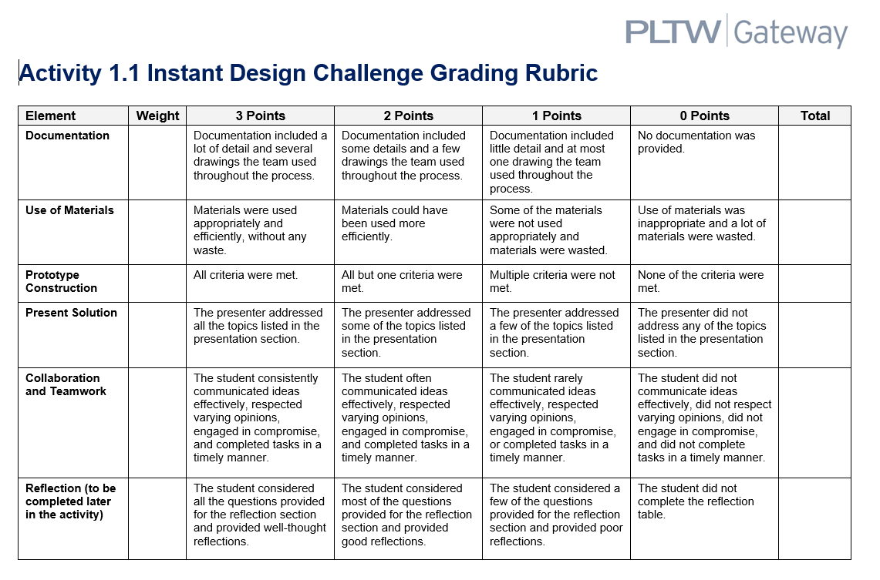

Slide 7
Breakouts
Questions to guide you: (breakup by course)
What do you use for formative?
Is this effective?
What do you use for summative?
Do you have any tips or tricks that work in your class

Slide 8
Large group share out
Do you have any tips or tricks that work in your class

Slide 9
PLTW Pacing Guides
How accurate are they?

Slide 10
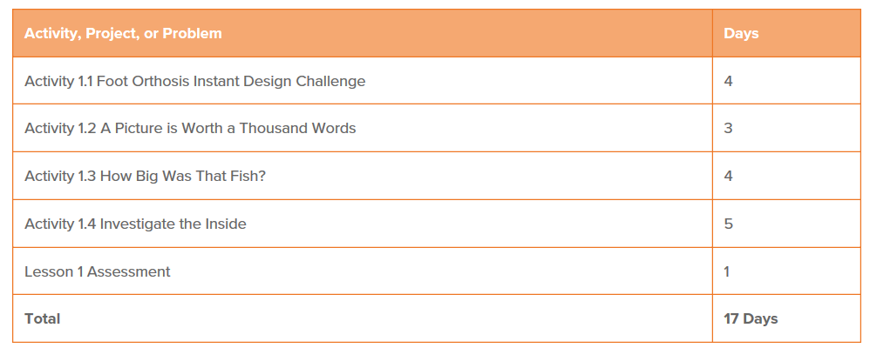

Slide 11
Bringing it home
When done effectively what does it look like?

Slide 13
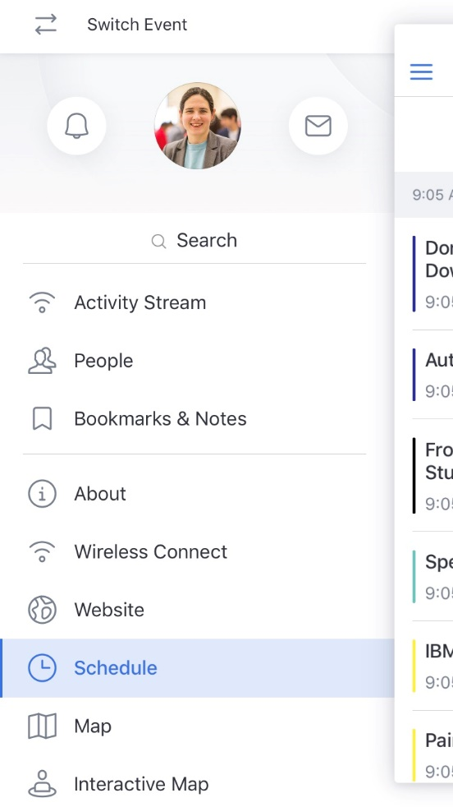
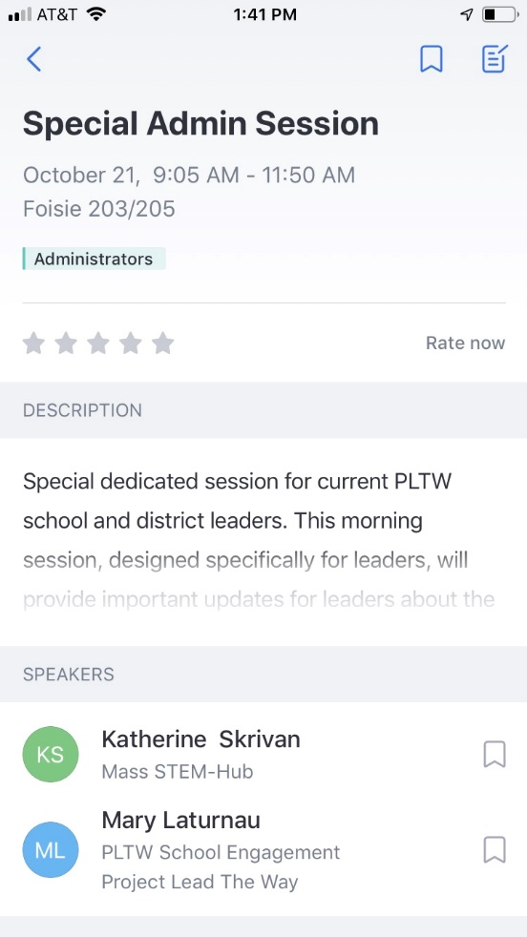
Rate this session in the conference app!

