Slide 1
Going from Good to Great:
Strategies to fostering student success with AR Projects
Notes:
In this session, we will be discussing strategies teachers can implement that will assist students with providing high quality projects. Particularly, projects will focus on those provided in Gateway AR, however, the tips and tricks presented are transferable across any project-based learning activity. (Review sign in) (Check in for work brought to the conference)

Slide 2
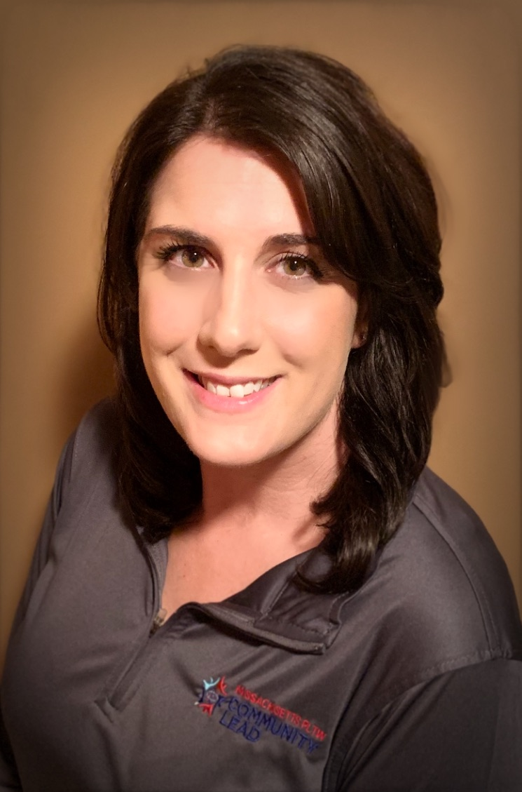
Hello!
I am Ashley Puopolo
I am here to help!
You can find me at apuopolo@stonehamschools.org
Massachusetts PLTW Community Lead for Gateway AR
STEM Specialist at Stoneham Central Middle School
Notes:
Gateway teacher for 5 years. Teaching AR DM FS ( Certified in ST MD)

Slide 3
http://bit.ly/MAGatewayAR
Notes:
Click here to access this presentation. There are hyperlinks embedded throughout this presentation

Slide 4
Define Great
Let’s start with our goal
Notes:
Have presenters go around the room to view projects and then, in small groups, discuss and share good vs. great descriptions

Slide 5
Automation Challenge:
MassDOT
Take a look at the following projects. Decide which prototypes and portfolios are good, and which are great.
Grand Prix-Dragster
Boston Billboard-Spinning Sign
Boston Bridge-Swing Bridge
Notes:
Projects are a themed spin off of the 12 automation tasks provided in the PLTW curriculum. Mention online searches and slight modifications.

Slide 6
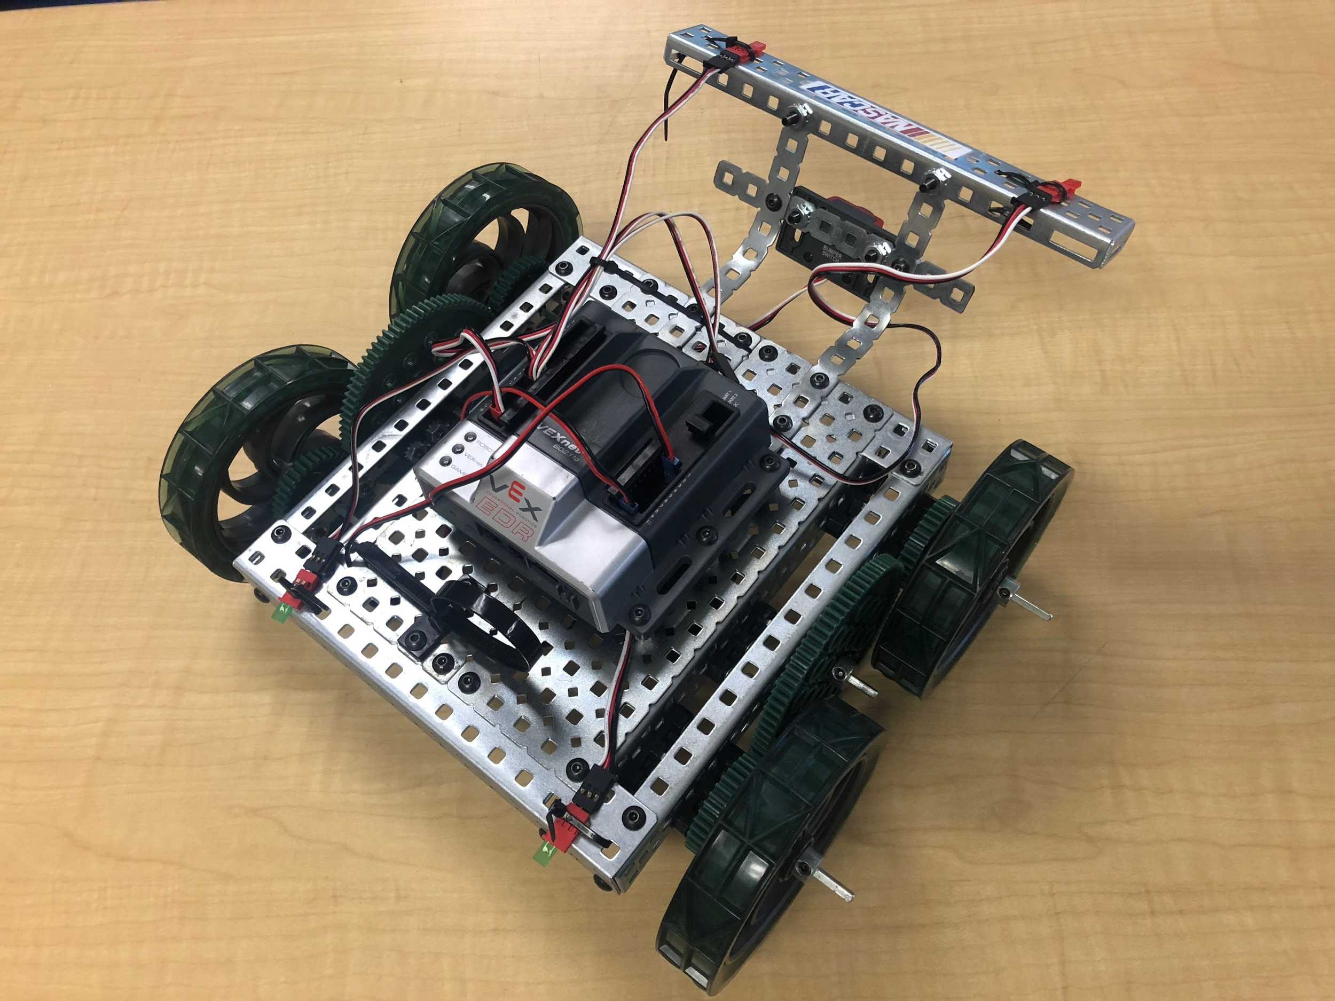
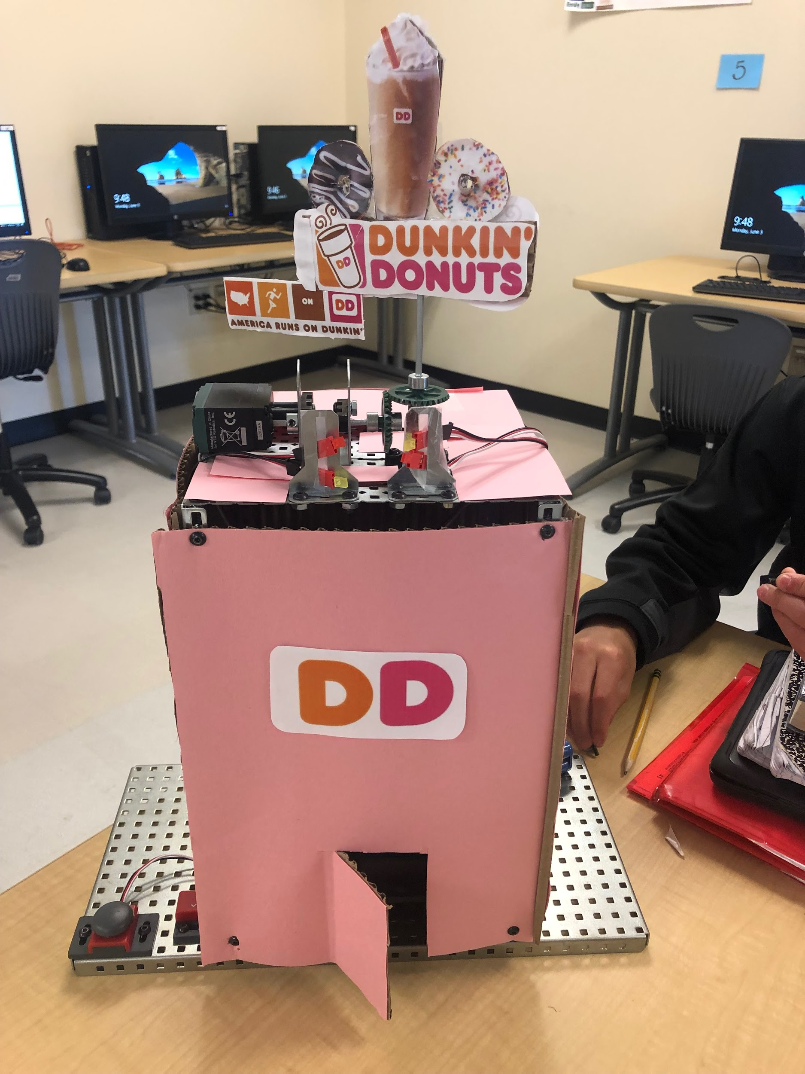
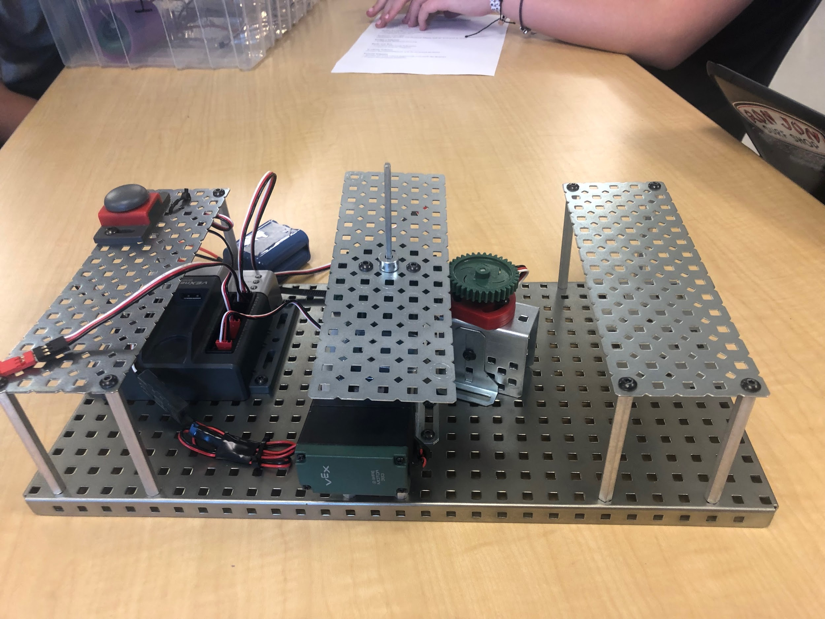
Automation Challenge:
MassDOT
Grand Prix
Portfolio 1
Portfolio 2
Video
Billboard
Portfolio 1
Portfolio 2
Video
Bridge
Portfolio 1
Portfolio 2
Video
Notes:
Review the following projects, or, think of your own AR automation projects. What makes them good? What makes them great?

Slide 7
Good vs. Great
What are some adjectives/characteristics that describe good and great projects
GOOD |  | GREAT
Mechanics, programming, meets criteria, works, group works together Sound structure |  | Everything is good with aesthetics Application of content-based activity developed knowledge to the problem/project
Notes:
Review, reflect, and record within your smaller groups

Slide 8
Strategies for Success
What are effective ways to foster higher expectations for student work

Slide 9
ENGINEERS ARE RESOURCEFUL
Group Dynamics/Roles
Rubrics/Checklist
Student Notes
Formal Assessments
Feedback Forms
Exemplar Showcase
Notes:
Group Dynamics-reflections/poster/Individual roles with CEO
Rubrics-student focus groups. Daily goals check ins
Student created notes/resources..”if only there was a resource for that..” Both RobotC and Mechanical Notes
Quizzez shows live feed and great data. Top 3 get a prize. Lower that 75% have homework.
Showcase can be schoolwide with class demonstrations, student voting, video in cafeteria, teacher vote, industry events, online challenges, etc
Feedback Forms vary to be Peer Review Project Recommendations

Slide 10
Share-a-thon
Click HERE to participate in our MA Gateway shared event!
Notes:
Share within smaller groups, what works in your classroom/takeaways from today’s session
Session share out: Modify work or share work via Share-a-thon

Slide 11
Thanks!
Any questions?
You can find me at apuopolo@stonehamschools.org
To join our Learning Teams https://tinyurl.com/learningteam-gateway
Check out the following slides to learn about upcoming events!
Notes:
Links to join other Networking Teams:
HS Engineering: https://tinyurl.com/learningteam-engineering19
HS CS: https://tinyurl.com/learningteam-compsci
HS Bio: https://tinyurl.com/learningteam-biomed
Gateway: https://tinyurl.com/learningteam-gateway
Launch: https://tinyurl.com/learningteam-launch

Slide 12
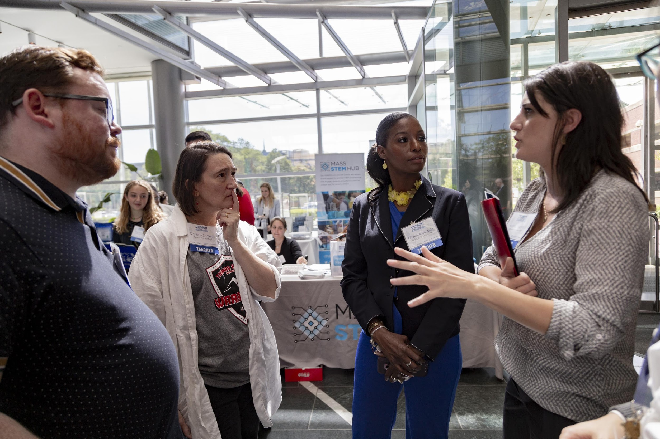
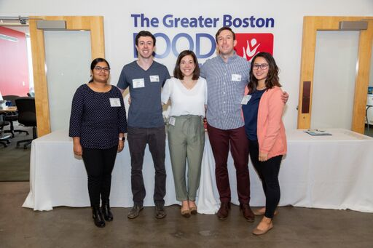
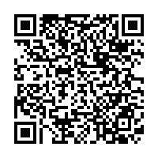
Teacher Industry Visits with Learning Teams
HS Eng: 11/5 12-3pm
Launch: 11/21 4-6pm
MS CS: 11/6 5:30-8pm
DM: 11/22 9am-1pm
AR: 11/14 1-3pm
CS: 11/26 10am-1pm
Sign Up: bit.ly/LT_Industry_Fall
HS Bio: Nov/Dec

Slide 13
2019-2020 Authentic Audience Opportunities
Online Industry Challenges
App Creators: Germ Fighters App Design
11/20 & 4/29
AR: Automation Through Programming
1/22
CSIM: Blinking Sign
11/20 & 3/25
DM: Foot Orthosis Instant Challenge
11/20 & 3/25
In-Person Student Events
January 29th
May 6th
June 3rd
Middle School Computer Science Innovators Showcase @ Microsoft NERD Center
Notes:
There will be more information to follow

